Slide 1

Current Building Industry Environment
Hostile Relations
Loss of Quality
Little Collaboration
False Value Engineering
Lengthy Schedules
Errors & Omissions
Claims and Litigation

Slide 2
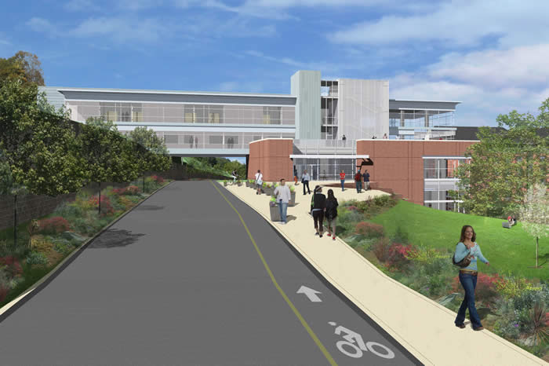
Building Industry
Project Introduction
Integrated Project Delivery
  Introduction
  West Village Commons IPD Guide
Structural Strategy
  Reason for Two Systems
  Redesign
  Cost, Duration
Energy Strategy
  Central Utility Plant
Façade Strategy
  Early Involvement
  Layout, Duration, Phasing, Cost,
Conclusion
Acknowledgements
Current Building Industry Environment
West Village Commons
Thesis Presentation
Integrated Project Solutions
to the
building Industry
Imagine – Getting the Building you wanted…
Hostile Relations
Loss of Quality
At the Price You Were Promised…
Little Collaboration
False Value Engineering
On the Day You Were Promised…
“People Seek Change, but Do Not Want to Be Changed”
-Peter Senge, The Fifth Discipline
--John Tocci, Tocci Building Companies
AGC’s Webinar, In The Trenches
Lengthy Schedules
Errors & Omissions
Claims and Litigation

Slide 3
Building Industry
Project Introduction
Integrated Project Delivery
  Introduction
  West Village Commons IPD Guide
Structural Strategy
  Reason for Two Systems
  Redesign
  Cost, Duration
Energy Strategy
  Central Utility Plant
Façade Strategy
  Early Involvement
  Layout, Duration, Phasing, Cost,
Conclusion
Acknowledgements
2003 Towson Master Plan
Issues
  Only One Building Addition in 25 Years
  $52 Million Dollar Maintenance Issue Backlog
  No Comprehensive Renovation for 90% of Facilities in 90 Years
  Majority of Students Live Off Campus, Not a Single Graduate Student Lives on Campus,
  Plans to add 2,500 Students Over 10 Years
Resolution
  West Village Campus

Slide 4
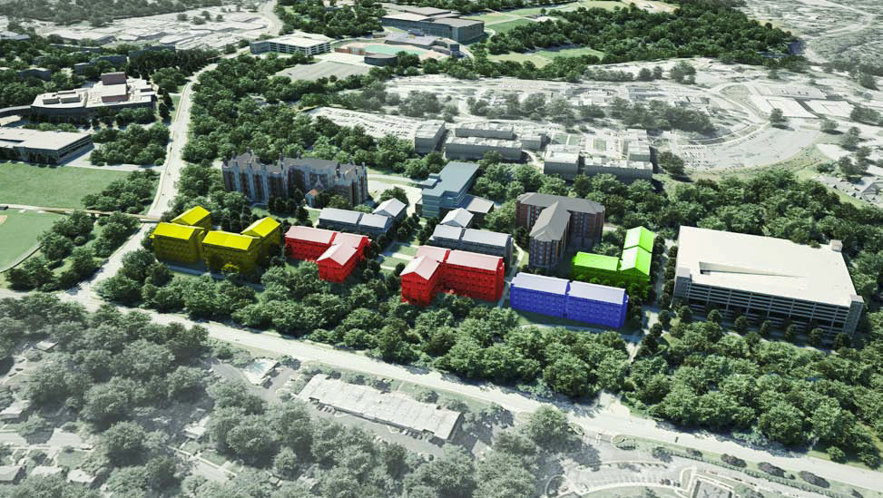
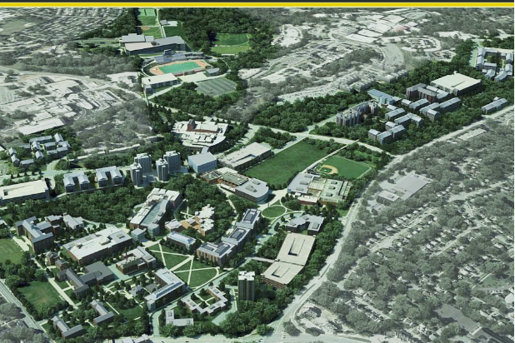
Building Industry
Project Introduction
Integrated Project Delivery
  Introduction
  West Village Commons IPD Guide
Structural Strategy
  Reason for Two Systems
  Redesign
  Cost, Duration
Energy Strategy
  Central Utility Plant
Façade Strategy
  Early Involvement
  Layout, Duration, Phasing, Cost,
Conclusion
Acknowledgements
2003 Towson Master Plan
Issues
  Only One Building Addition in 25 Years
  $52 Million Dollar Maintenance Issue Backlog
  No Comprehensive Renovation for 90% of Facilities in 90 Years
  Majority of Students Live Off Campus, Not a Single Graduate Student Lives on Campus,
  Plans to add 2,500 Students Over 10 Years
Resolution
  West Village Campus
West Village
  8 Apartments Over Ten Years
  Parking Garage
  Architectural Centerpiece- West Village Commons

Slide 5
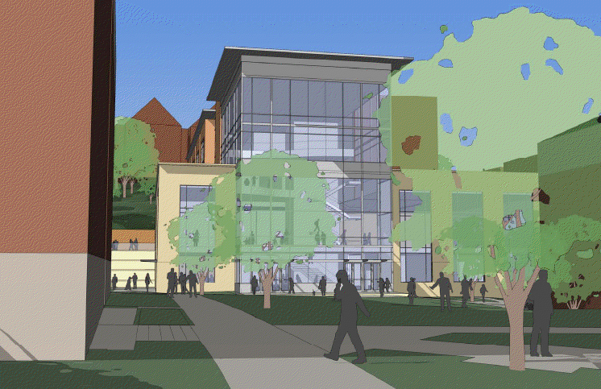
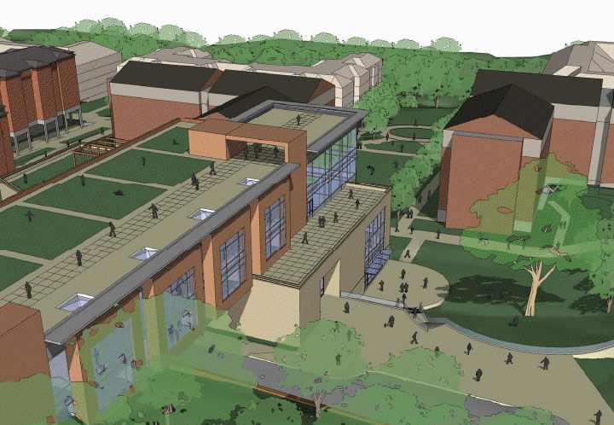

Building Industry
Project Introduction
Integrated Project Delivery
  Introduction
  West Village Commons IPD Guide
Structural Strategy
  Reason for Two Systems
  Redesign
  Cost, Duration
Energy Strategy
  Central Utility Plant
Façade Strategy
  Early Involvement
  Layout, Duration, Phasing, Cost,
Conclusion
Acknowledgements
West Village Commons
Project Team
Architect – GWWO, Inc
Constructor – Barton Malow Co.
MEP Engineer – James Posey, Ass.
Structural Engineer – ReSTL Engineers
Project Information
85,000 Square Feet
July 2009 – May 2011
$30.4 Million
CM At Risk with GMP

Slide 6
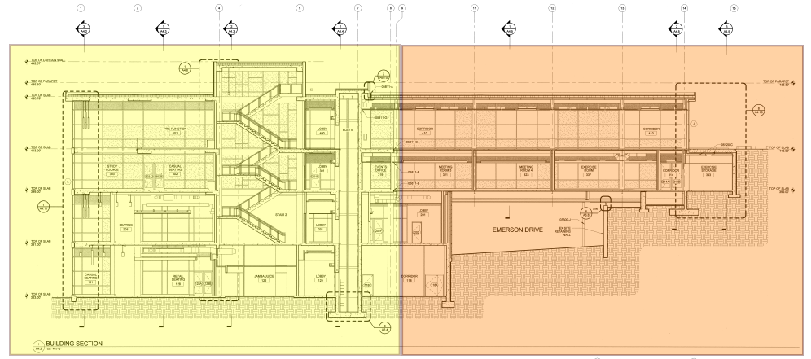
Building Industry
Project Introduction
Integrated Project Delivery
  Introduction
  West Village Commons IPD Guide
Structural Strategy
  Reason for Two Systems
  Redesign
  Cost, Duration
Energy Strategy
  Central Utility Plant
Façade Strategy
  Early Involvement
  Layout, Duration, Phasing, Cost,
Conclusion
Acknowledgements
Building Systems
Total Project Cost
Package | Total Project Cost (TC) | TC/SF | MBE Participation**
CM Preconstruction | $300,000.00 | $3.53 | $0.00
Bid Package A | $7,120,965.00 | $83.78 | $1,432,510.00
Bid Package B | $22,961,029.00 | $270.13 | $5,885,843.00
Total | $30,381,994.00 | $357.44† | $7,318,353.00
Architectural
“Bridge” Over Emerson Dr.
Large Multipurpose Rooms, Folding Partitions
Extensive Kitchen/Dining Space
Structural
RAM Aggregate Piers
CIP Concrete North End
Structural Steel South End
Mechanical
Seven Air Handling Units
Two 3000 MBH Boilers
3535 MBH Chiller
Facade
Glazed Curtain Wall
Brick Masonry
Aluminum Metal Panel
Concrete
Steel

Slide 7
Building Industry
Project Introduction
Integrated Project Delivery
  Introduction
  West Village Commons IPD Guide
Structural Strategy
  Reason for Two Systems
  Redesign
  Cost, Duration
Energy Strategy
  Central Utility Plant
Façade Strategy
  Early Involvement
  Layout, Duration, Phasing, Cost,
Conclusion
Acknowledgements
Integrated Project Delivery
Goals
Cleary Define What IPD Is…
Create a WVC IPD Execution Guide
Develop Cost Saving Strategies that IPD Enables
“…A project approach that integrates people, systems, business structures and practices into a process that collaboratively harnesses the talents and insights of all participants to optimize project results, increase value to the owner, reduce waste, and maximize efficiency through all phases of design, fabrication, and construction.”(AIA)

Slide 8
Building Industry
Project Introduction
Integrated Project Delivery
  Introduction
  West Village Commons IPD Guide
Structural Strategy
  Reason for Two Systems
  Redesign
  Cost, Duration
Energy Strategy
  Central Utility Plant
Façade Strategy
  Early Involvement
  Layout, Duration, Phasing, Cost,
Conclusion
Acknowledgements
Three Elements of IPD
I. Single Contractual Relation
  Shared Risk and Shared Reward
  Part of Profit Based on Project Goals
  Strong Reliance on each other… “Trust is the
Foundation of IPD”
II. Early Owner Selected Key Members
  Requires Sophisticated/Trusting Owner
  Selection at Project Inception
  Include Subs/Consults as Key Members or “Lean Core”

Slide 9

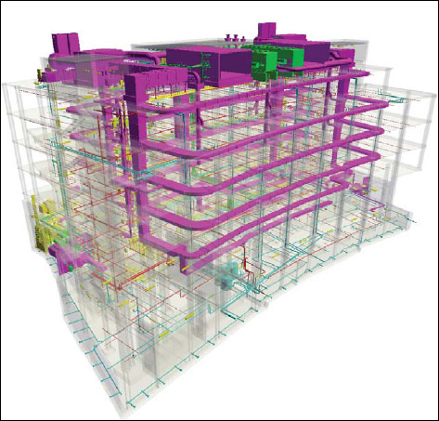






Building Industry
Project Introduction
Integrated Project Delivery
  Introduction
  West Village Commons IPD Guide
Structural Strategy
  Reason for Two Systems
  Redesign
  Cost, Duration
Energy Strategy
  Central Utility Plant
Façade Strategy
  Early Involvement
  Layout, Duration, Phasing, Cost,
Conclusion
Acknowledgements
Three Elements of IPD
I. Single Contractual Relation
  Shared Risk and Shared Reward
  Part of Profit Based on Project Goals
  Strong Reliance on each other… “Trust is the
Foundation of IPD”
II. Early Owner Selected Key Members
  Requires Sophisticated/Trusting Owner
  Selection at Project Inception
  Include Subs/Consults as Key Members or “Lean Core”
Communication and Design Tools
“BIM is an IPD Enabler”
BIM Technologies Missing a Link to Reach Full Potential
www.AECbytes.com

Slide 10
Building Industry
Project Introduction
Integrated Project Delivery
  Introduction
  West Village Commons IPD Guide
Structural Strategy
  Reason for Two Systems
  Redesign
  Cost, Duration
Energy Strategy
  Central Utility Plant
Façade Strategy
  Early Involvement
  Layout, Duration, Phasing, Cost,
Conclusion
Acknowledgements
Three Elements of IPD
III. One Universal Model
Integration of Design and Fabrication Drawings
3D Layout
Material Tracking
Quality Control
Accurate Take-offs and Estimates
Target Value Design
I. Single Contractual Relation
  Shared Risk and Shared Reward
  Part of Profit Based on Project Goals
  Strong Reliance on each other… “Trust is the
Foundation of IPD”
II. Early Owner Selected Key Members
  Requires Sophisticated/Trusting Owner
  Selection at Project Inception
  Include Subs/Consults as Key Members or “Lean Core”
www.AECbytes.com

Slide 11
Building Industry
Project Introduction
Integrated Project Delivery
  Introduction
  West Village Commons IPD Guide
Structural Strategy
  Reason for Two Systems
  Redesign
  Cost, Duration
Energy Strategy
  Central Utility Plant
Façade Strategy
  Early Involvement
  Layout, Duration, Phasing, Cost,
Conclusion
Acknowledgements
West Village IPD Execution Guide
Project Executive Team
AIA C191
  Basis for Execution Guide
  Amendments Allow Evolving Contract
  Target Value Cost Design
  Project Executive Team, Project Management Team
  Redefined Delivery Phasing
  Lean Core Members/Selection
  Design Clusters & Strategies

Slide 12
Building Industry
Project Introduction
Integrated Project Delivery
  Introduction
  West Village Commons IPD Guide
Structural Strategy
  Reason for Two Systems
  Redesign
  Cost, Duration
Energy Strategy
  Central Utility Plant
Façade Strategy
  Early Involvement
  Layout, Duration, Phasing, Cost,
Conclusion
Acknowledgements
West Village IPD Execution Guide
Project Executive Team
AIA C191
  Basis for Execution Guide
  Amendments Allow Evolving Contract
  Target Value Cost Design
  Project Executive Team, Project Management Team
  Redefined Delivery Phasing
  Lean Core Members/Selection
  Design Clusters & Strategies
David Mayhew
Director of AEC
Towson University
Alan Reed
Head Architect
GWWO, Inc.
Ben Morgan
Project Director
Barton Malow

Slide 13
Building Industry
Project Introduction
Integrated Project Delivery
  Introduction
  West Village Commons IPD Guide
Structural Strategy
  Reason for Two Systems
  Redesign
  Cost, Duration
Energy Strategy
  Central Utility Plant
Façade Strategy
  Early Involvement
  Layout, Duration, Phasing, Cost,
Conclusion
Acknowledgements
West Village IPD Execution Guide
Project Management Team
AIA C191
  Basis for Execution Guide
  Amendments Allow Evolving Contract
  Target Value Cost Design
  Project Executive Team, Project Management Team
  Redefined Delivery Phasing
  Lean Core Members/Selection
  Design Clusters & Strategies
Andy Powell
Project Manager
Towson University
LC Input
Bill Melluish
Project Manager
GWWO, Inc.
Derrick Foster
Project Manager
Barton Malow

Slide 14
Building Industry
Project Introduction
Integrated Project Delivery
  Introduction
  West Village Commons IPD Guide
Structural Strategy
  Reason for Two Systems
  Redesign
  Cost, Duration Phasing
Energy Strategy
  Central Utility Plant
Façade Strategy
  Early Involvement
  Layout, Duration, Phasing, Cost,
Conclusion
Acknowledgements
West Village IPD Execution Guide
Redefined Delivery Phasing
AIA C191
  Basis for Execution Guide
  Amendments Allow Evolving Contract
  Target Value Cost Design
  Project Executive Team, Project Management Team
  Redefined Delivery Phasing
  Lean Core Members/Selection
  Design Clusters & Strategies

Slide 15
Building Industry
Project Introduction
Integrated Project Delivery
  Introduction
  West Village Commons IPD Guide
Structural Strategy
  Reason for Two Systems
  Redesign
  Cost, Duration
Energy Strategy
  Central Utility Plant
Façade Strategy
  Early Involvement
  Layout, Duration, Phasing, Cost,
Conclusion
Acknowledgements
West Village IPD Execution Guide
Redefined Delivery Phasing
Conceptualization
  Contract Execution, PM Team Formation, Go/No-Go
Criteria Design
  Project Specific Goals, LC Members Selected, Schematic Designs, Broad Budget and Schedule
Detailed Design
  Target Value Cost Set (beginning), Architecture Complete, System Design through Design Clusters
Implementation
  All engineering complete, Fabrication Begins, Preconstruction, Bid process begins for Non - LC
AIA C191
  Basis for Execution Guide
  Amendments Allow Evolving Contract
  Target Value Cost Design
  Project Executive Team, Project Management Team
  Redefined Delivery Phasing
  Lean Core Members/Selection
  Design Clusters & Strategies

Slide 16
Building Industry
Project Introduction
Integrated Project Delivery
  Introduction
  West Village Commons IPD Guide
Structural Strategy
  Reason for Two Systems
  Redesign
  Cost, Duration
Energy Strategy
  Central Utility Plant
Façade Strategy
  Early Involvement
  Layout, Duration, Phasing, Cost,
Conclusion
Acknowledgements
West Village IPD Execution Guide
Redefined Delivery Phasing
Agency Review
  Will be ongoing throughout Implementation and Detailed Design
Buyout
  Final Project Team Selected
Construction
Closeout
  Project Goals Evaluated, Compensation
AIA C191
  Basis for Execution Guide
  Amendments Allow Evolving Contract
  Target Value Cost Design
  Project Executive Team, Project Management Team
  Redefined Delivery Phasing
  Lean Core Members/Selection
  Design Clusters & Strategies

Slide 17
Building Industry
Project Introduction
Integrated Project Delivery
  Introduction
  West Village Commons IPD Guide
Structural Strategy
  Reason for Two Systems
  Redesign
  Cost, Duration
Energy Strategy
  Central Utility Plant
Façade Strategy
  Early Involvement
  Layout, Duration, Phasing, Cost,
Conclusion
Acknowledgements
West Village IPD Execution Guide
Lean Core Members/Selection
AIA C191
  Basis for Execution Guide
  Amendments Allow Evolving Contract
  Target Value Cost Design
  Project Executive Team, Project Management Team
  Redefined Delivery Phasing
  Lean Core Members/Selection
  Design Clusters & Strategies
Primary
  Steel Fabricator/Erector
  Structural Engineer
  Civil Engineer
  Kitchen Consultant/Vendor
  MEP Engineer*
  MEP Contractor(s)*
  Precast Subcontractor
  Curtain Wall Contractor
Secondary
  Fire Suppression Engineer*
  Fire Suppression Contractor*
  Drywall Contractor
  Lighting Consultant
  Sustainability Consultant
  Commissioning Agent
*Can Be Combined as a Design/Build Firm

Slide 18
Building Industry
Project Introduction
Integrated Project Delivery
  Introduction
  West Village Commons IPD Guide
Structural Strategy
  Reason for Two Systems
  Redesign
  Cost, Duration
Energy Strategy
  Central Utility Plant
Façade Strategy
  Early Involvement
  Layout, Duration, Phasing, Cost,
Conclusion
Acknowledgements
West Village IPD Execution Guide
Design Clusters and Strategies
AIA C191
  Basis for Execution Guide
  Amendments Allow Evolving Contract
  Target Value Cost Design
  Project Executive Team, Project Management Team
  Redefined Delivery Phasing
  Lean Core Members/Selection
  Design Clusters & Strategies
Structural Design Cluster
MEP Design Cluster
Façade Design Cluster
Kitchen/Food Service Design Cluster
Utility Plant Design Cluster
Site Plan and Safety Design Cluster

Slide 19
Building Industry
Project Introduction
Integrated Project Delivery
  Introduction
  West Village Commons IPD Guide
Structural Strategy
  Reason for Two Systems
  Redesign
  Cost, Duration
Energy Strategy
  Central Utility Plant
Façade Strategy
  Early Involvement
  Layout, Duration, Phasing, Cost,
Conclusion
Acknowledgements
Structural Strategy
Goals
  Design and develop economical and efficient structural system
  Criteria for design will be based on project loads, initial costs, schedule impacts, coordination, safety, and impact on other building systems.
Structural Design Cluster
Structural Engineer
(LC)
Project Engineer
BMC
Steel Fabricator (LC)
Civil Engineer
(LC)
Original Design
  Originally all Steel Structure
  Barton Malow Suggests Concrete for North End and Steel for the South End to Begin Earlier
Opportunity for Resolution
  Expensive and Long Duration; Weather Impact
  Difficult Coordination Efforts
Integrated Solution
  IPD Will Allow for Steel Fabrication to Begin Earlier
  Design a Structural Steel System to Take Advantage of Construction Speed and Cost

Slide 20
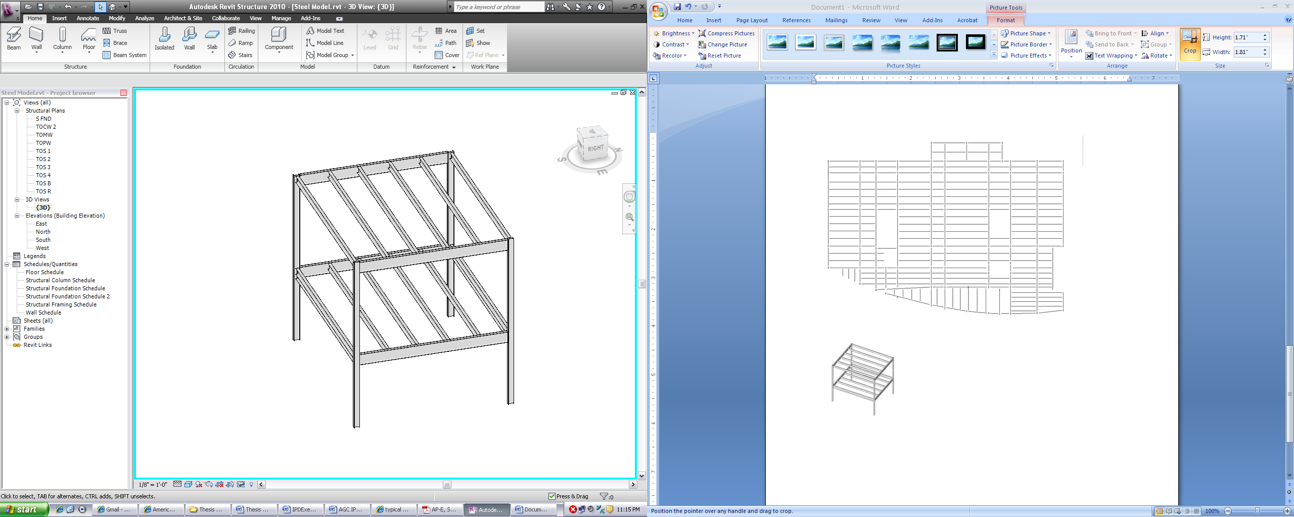
Building Industry
Project Introduction
Integrated Project Delivery
  Introduction
  West Village Commons IPD Guide
Structural Strategy
  Reason for Two Systems
  Redesign
  Cost, Duration
Energy Strategy
  Central Utility Plant
Façade Strategy
  Early Involvement
  Layout, Duration, Phasing, Cost,
Conclusion
Acknowledgements
Structural Strategy
G
K
4
5
27’ x 33’ Bay Size
4 Beams Spaced 6’ – 6”
Columns Splice – 31’

Slide 21
Building Industry
Project Introduction
Integrated Project Delivery
  Introduction
  West Village Commons IPD Guide
Structural Strategy
  Reason for Two Systems
  Redesign
  Cost, Duration
Energy Strategy
  Central Utility Plant
Façade Strategy
  Early Involvement
  Layout, Duration, Phasing, Cost,
Conclusion
Acknowledgements
Structural Strategy
Typical Bay: Roof and Floor Below, Columns
Roof
  Live Load = 30 psf (includes snow)
  Dead Load = 85 psf (deck, LWC, Roofing, MEP, Self Weight)
  w = 1.2(D_{L} * A_{t}) + 0.5(L_{L} * A_{t})
  Beams
    w = 760.5 lbs/ft
    M_{U} = wl²/8 = 69.3 Kips – ft
    V_{U} = wl/2 = 10.27 Kips
  Girders
    w = 2.49 kips/ft
    M_{U} = wl²/8 = 340.3 Kips – ft
    V_{U} = wl/2 = 41.91 Kips
Girders: W24 x 55
Beams: W 14 x 22

Slide 22
Building Industry
Project Introduction
Integrated Project Delivery
  Introduction
  West Village Commons IPD Guide
Structural Strategy
  Reason for Two Systems
  Redesign
  Cost, Duration
Energy Strategy
  Central Utility Plant
Façade Strategy
  Early Involvement
  Layout, Duration, Phasing, Cost,
Conclusion
Acknowledgements
Structural Strategy
Typical Bay: Roof and Floor Below, Columns
Roof
  Live Load = 30 psf (includes snow)
  Dead Load = 85 psf (deck, LWC, Roofing, MEP, Self Weight)
  w = 1.2(D_{L} * A_{t}) + 0.5(L_{L} * A_{t})
  Beams
    w = 760.5 lbs/ft
    M_{U} = wl²/8 = 69.3 Kips – ft
    V_{U} = wl/2 = 10.27 Kips
  Girders
    w = 2.49 kips/ft
    M_{U} = wl²/8 = 340.3 Kips – ft
    V_{U} = wl/2 = 41.91 Kips
Fourth Floor
  Live Load = 100 psf
  Dead Load = 70 psf (Deck, LWC, MEP, Self Weight)
  w = 1.2(D_{l} * A_{t}) + 1.6 (L_{L} * A_{t})
  Beams
    w = 760.5 lbs/ft
    M_{U} = wl²/8 = 69.3 Kips – ft
    V_{U} = wl/2 = 10.27 Kips
  Girders
    w = 2.49 kips/ft
    M_{U} = wl²/8 = 340.3 Kips – ft
    V_{U} = wl/2 = 41.91 Kips
Girders: W24 x 55
Beams: W 14 x 22
Girders: W24 x 84
Beams: W 14 x 34

Slide 23
Building Industry
Project Introduction
Integrated Project Delivery
  Introduction
  West Village Commons IPD Guide
Structural Strategy
  Reason for Two Systems
  Redesign
  Cost, Duration
Energy Strategy
  Central Utility Plant
Façade Strategy
  Early Involvement
  Layout, Duration, Phasing, Cost,
Conclusion
Acknowledgements
Structural Strategy
Typical Bay: Roof and Floor Below, Columns
Columns
  Load from fourth floor bay
    214.5 Kips
  Load from roof bay
    104.36 Kips
  Total load on Column
    P_{U} = 318.86 Kips
  Typical length is 31 feet
  r_{X}/r_{Y} = 2.64
  KL_{eff} = 11.74
Columns: W12 x 40

Slide 24
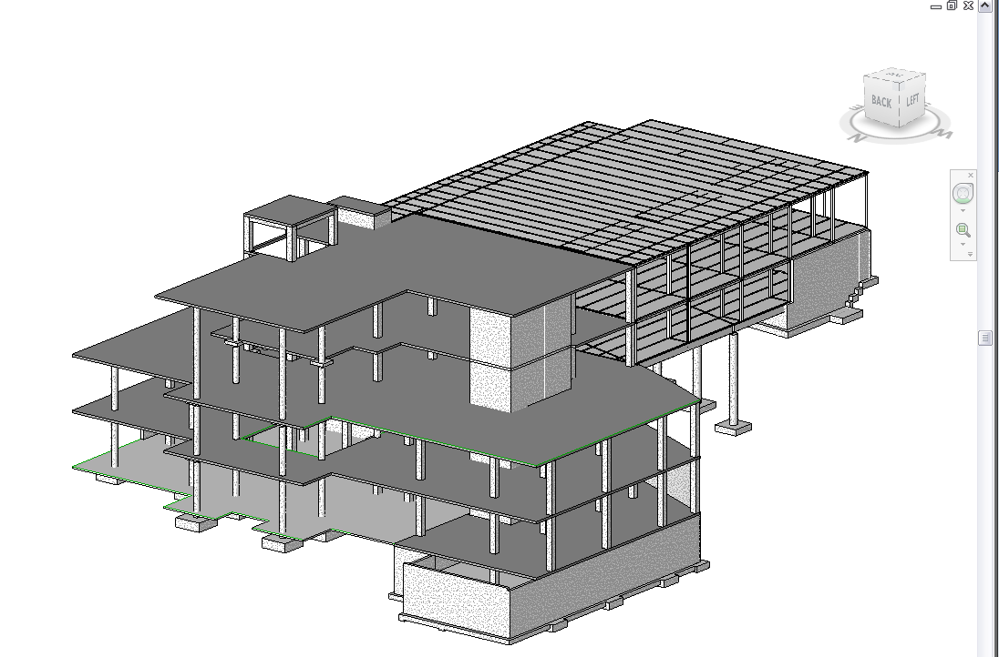
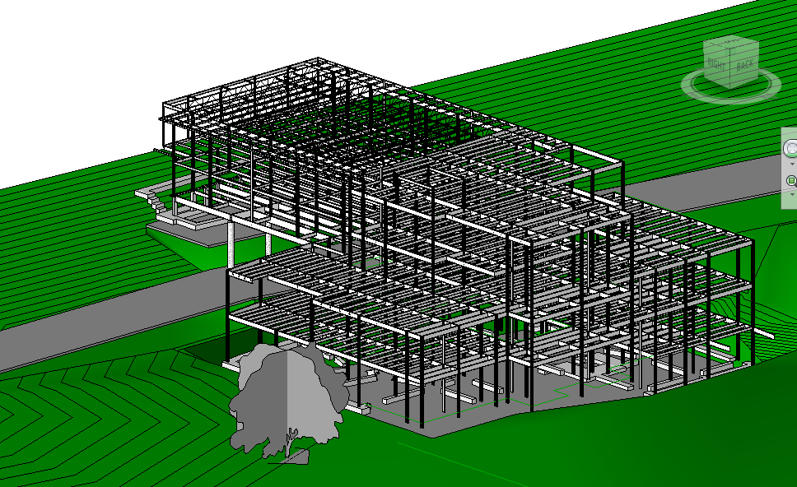
Building Industry
Project Introduction
Integrated Project Delivery
  Introduction
  West Village Commons IPD Guide
Structural Strategy
  Reason for Two Systems
  Redesign
  Cost, Duration
Energy Strategy
  Central Utility Plant
Façade Strategy
  Early Involvement
  Layout, Duration, Phasing, Cost,
Conclusion
Acknowledgements
Structural Strategy

Slide 25
Building Industry
Project Introduction
Integrated Project Delivery
  Introduction
  West Village Commons IPD Guide
Structural Strategy
  Reason for Two Systems
  Redesign
  Cost, Duration
Energy Strategy
  Central Utility Plant
Façade Strategy
  Early Involvement
  Layout, Duration, Phasing, Cost,
Conclusion
Acknowledgements
Structural Strategy
Cost
Cost of Steel = $2,600 per ton
LWC on Metal Deck = $184/CY
Welded Wire Mesh (6x6 W2.9 x W2.9) = $57/CSF
Metal Decking = $3.15/SF
Roof Decking = $2.80/SF
Duration
Original Duration on Critical Path
  118 Days = 23.6 Weeks
New Duration (Assuming entirely on Critical Path)
  68 Days = 13.6 Weeks
Savings
  10 Weeks = $271,061 in General Conditions & Fee
Original Estimate of Structure = $3,235,398
  New Estimate of Structure = $3,001,419
  Savings = $233,978.70
Total Savings
  $505,040 and 2.5 Months

Slide 26
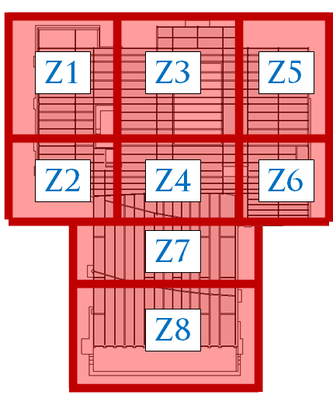
Building Industry
Project Introduction
Integrated Project Delivery
  Introduction
  West Village Commons IPD Guide
Structural Strategy
  Reason for Two Systems
  Redesign
  Cost, Duration
Energy Strategy
  Central Utility Plant
Façade Strategy
  Early Involvement
  Layout, Duration, Phasing, Cost,
Conclusion
Acknowledgements
Structural Strategy

Slide 27
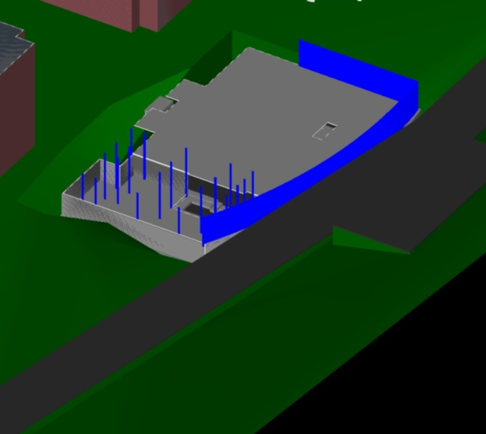
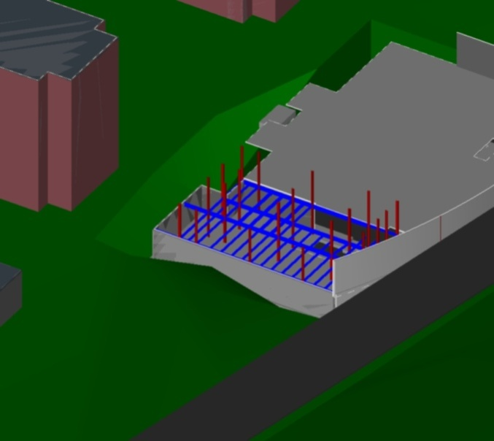
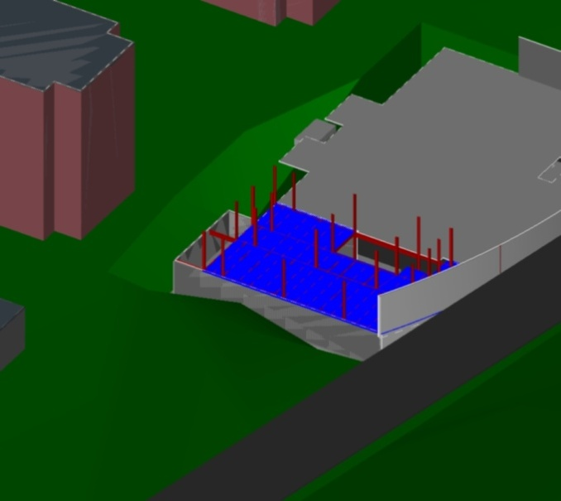
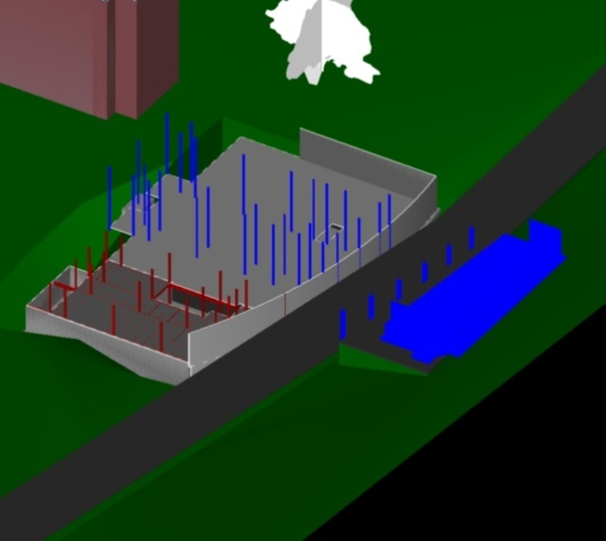
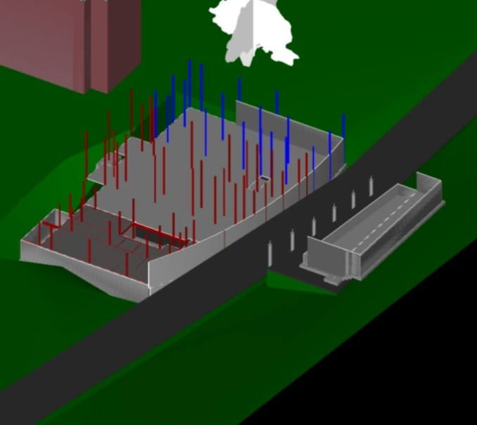
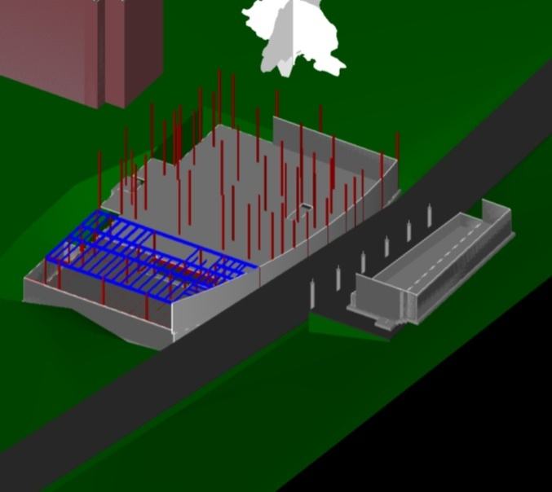
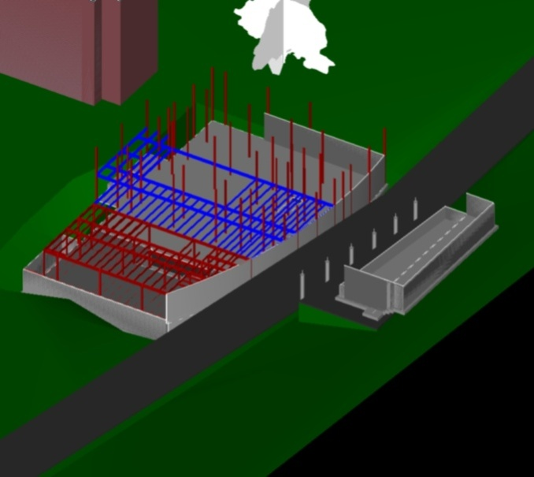
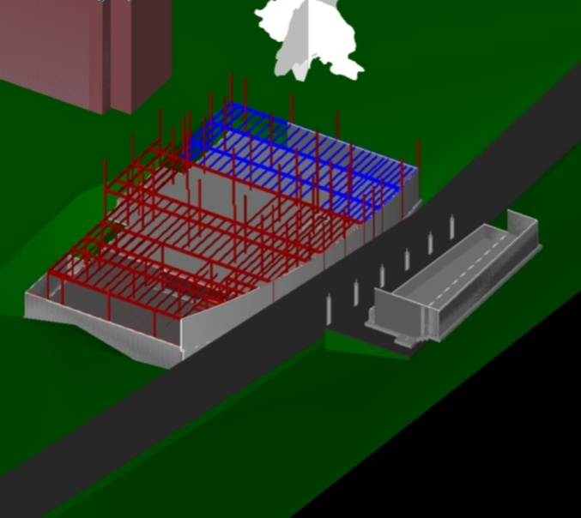
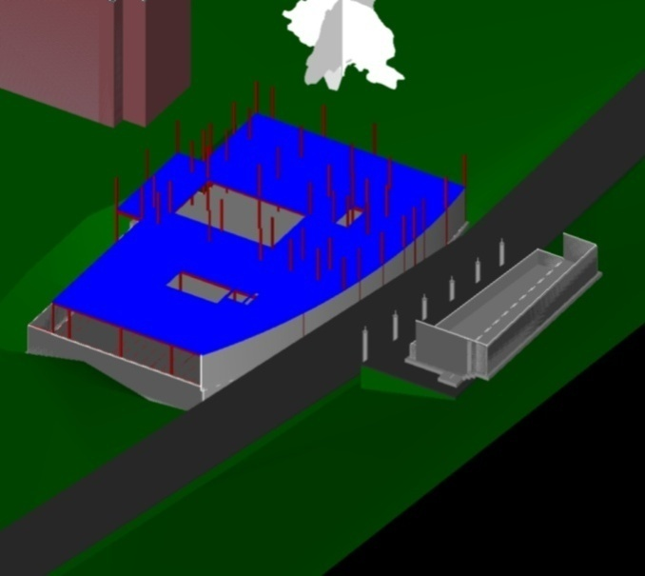
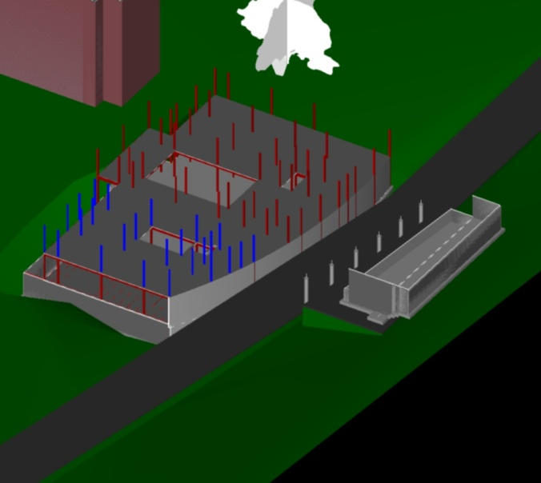
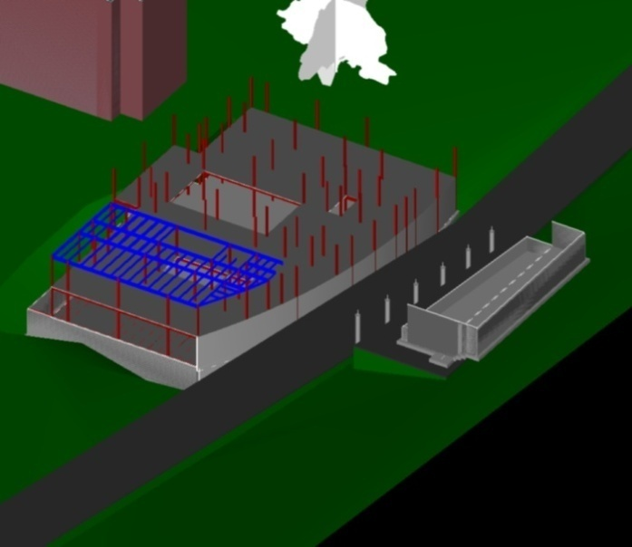
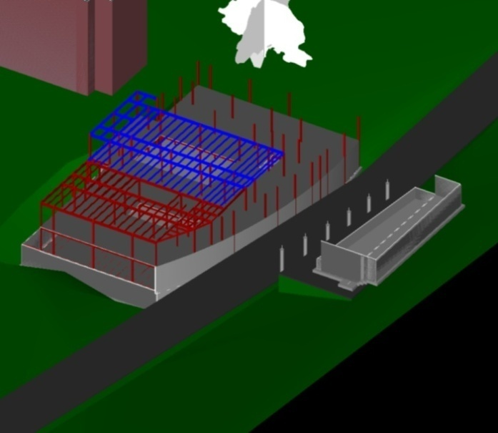
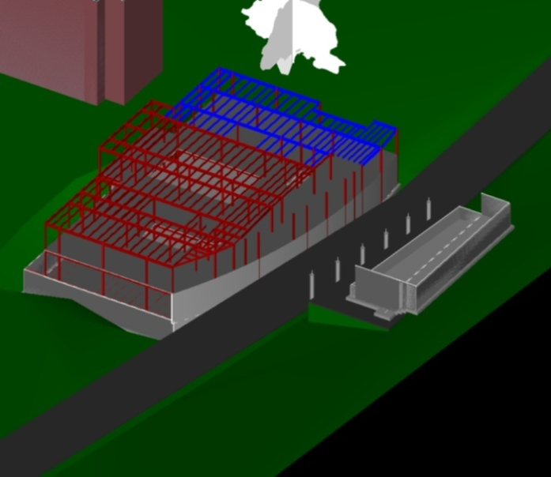
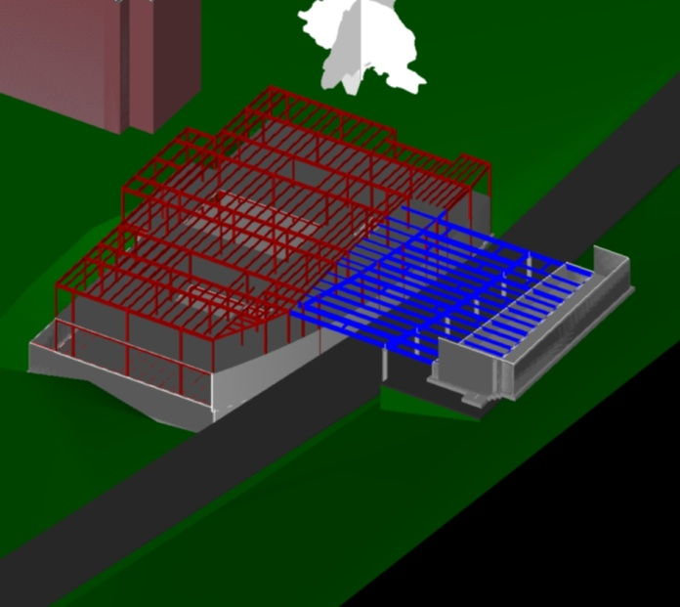
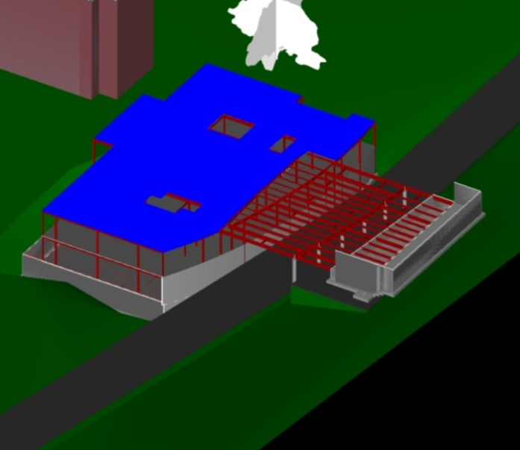
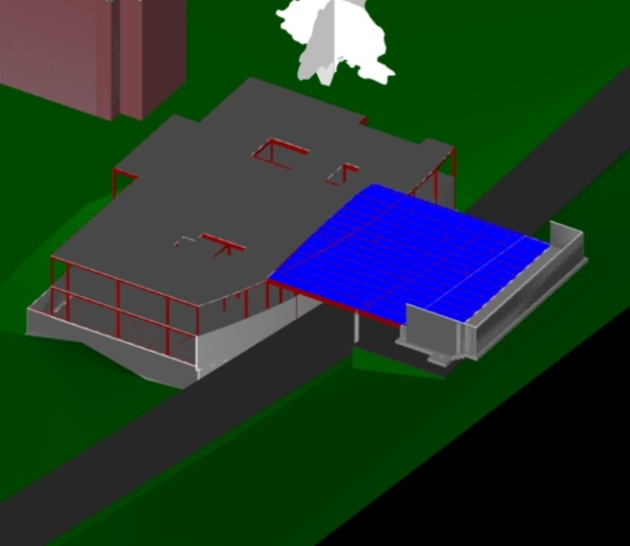
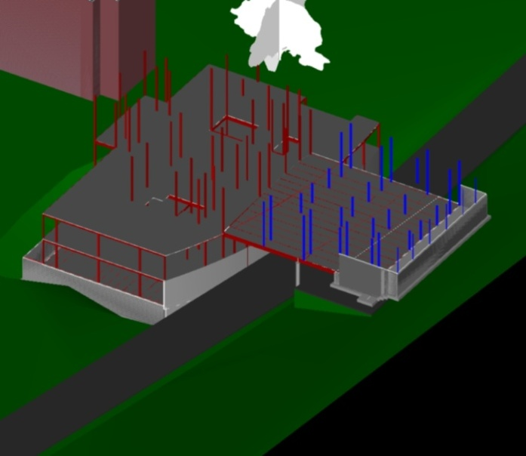
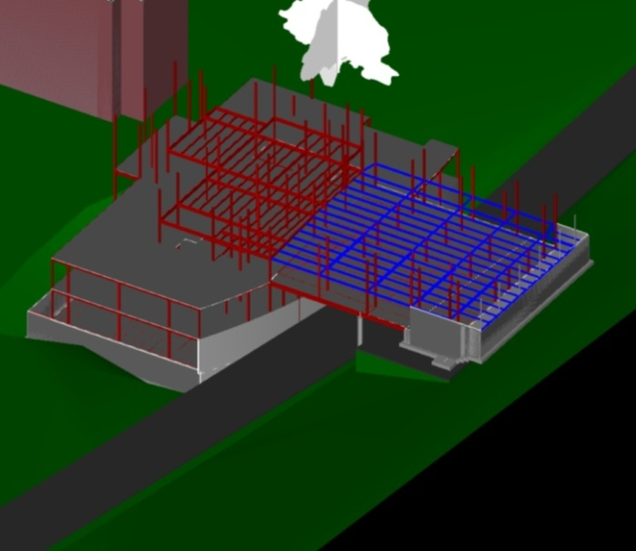

Slide 28
Building Industry
Project Introduction
Integrated Project Delivery
  Introduction
  West Village Commons IPD Guide
Structural Strategy
  Reason for Two Systems
  Redesign
  Cost, Duration
Energy Strategy
  Central Utility Plant
Façade Strategy
  Early Involvement
  Layout, Duration, Phasing, Cost,
Conclusion
Acknowledgements
West Village Utility Plant
Opportunity for Resolution
  East Campus Plant Too Far, Maxed Out
  Inefficient Decentralized Design for 8 Apartments and Commons
Integrated Solution
  Design a Central Utility Plant, Phased Over 10 Years
  Provide Heating and Cooling at Differing Peak Capacities
Goals
  Conduct Energy Study for West Village
  Determine Initial Costs Versus Long Term Savings
Utility Plant Design Cluster
TU Project Manager
Project Engineer
BMC
TU Facilities Management
MEP Engineer
MEP
Subcontractors
(LC)

Slide 29
Building Industry
Project Introduction
Integrated Project Delivery
  Introduction
  West Village Commons IPD Guide
Structural Strategy
  Reason for Two Systems
  Redesign
  Cost, Duration
Energy Strategy
  Central Utility Plant
Façade Strategy
  Early Involvement
  Layout, Duration, Phasing, Cost,
Conclusion
Acknowledgements
West Village Utility Plant
Cooling
  Central Chilled Water System
  Three 900 ton chillers to be run at 75% each. Two chillers would be able to handle the load if one were to go down.
Heating
  Three 12,000 MBH rated hot water boilers running on natural gas
1
2
3

Slide 30
Building Industry
Project Introduction
Integrated Project Delivery
  Introduction
  West Village Commons IPD Guide
Structural Strategy
  Reason for Two Systems
  Redesign
  Cost, Duration
Energy Strategy
  Central Utility Plant
Façade Strategy
  Early Involvement
  Layout, Duration, Phasing, Cost,
Conclusion
Acknowledgements
Façade Strategy
Facade Design Cluster
Project Architect
GWWO, Inc
Project Engineer
BMC
Precast Subcontractor
(LC)
Structural Engineer (LC)
CurtainWall Subcontractor
(LC)
Opportunity for Resolution
  Early Involvement Opens the Door to Prefabrication
  Curtain Wall, Brick Masonry Wall, Metal Panels, and Exterior Framing Large Part of Critical Path
Integrated Solution
  Utilize Prefabricated Masonry Panels Brick Walls
  Can Be Installed Without Metal Framing First
Goals
  Design and Develop an Economical Façade System in with the Architecture Team’s Design Intent.
  Analyze Increase in Material Cost vs Speed of Construction
  Communicate with Structural Design Cluster

Slide 32
Building Industry
Project Introduction
Integrated Project Delivery
  Introduction
  West Village Commons IPD Guide
Structural Strategy
  Reason for Two Systems
  Redesign
  Cost, Duration
Energy Strategy
  Central Utility Plant
Façade Strategy
  Early Involvement
  Layout, Duration, Phasing, Cost,
Conclusion
Acknowledgements

Slide 33
Building Industry
Project Introduction
Integrated Project Delivery
  Introduction
  West Village Commons IPD Guide
Structural Strategy
  Reason for Two Systems
  Redesign
  Cost, Duration
Energy Strategy
  Central Utility Plant
Façade Strategy
  Early Involvement
  Layout, Duration, Phasing, Cost,
Conclusion
Acknowledgements
Façade Strategy
Façade Construction Costs
 | ELV | Unit | QTY | THK (in) | Cubic Feet | Unit Wt | Wt (tons) | Cost $/Unit | Total Cost
Panels
 | East | SF | 2,180 | 7 | 1,272 | 155 pcf | 99 | $55.00 | $119,900.00
 | West | SF | 2,993 | 7 | 1,746 | 155 pcf | 135 | $55.00 | $164,615.00
 | North | SF | 3,472 | 7 | 2,025 | 155 pcf | 157 | $55.00 | $190,960.00
 | South | SF | 4,969 | 7 | 2,899 | 155 pcf | 225 | $55.00 | $273,295.00
 |  | Total | 13,614 | Total | 7,942 | Total | 615 | Total | $748,770.00
Brick Masonry
 | East | SF | 2,180 | 4 | 727 | 42 psf | 46 | $24.00 | $52,320.00
 | West | SF | 2,993 | 4 | 998 | 42 psf | 63 | $24.00 | $71,832.00
 | North | SF | 3,472 | 4 | 1,157 | 42 psf | 73 | $24.00 | $83,328.00
 | South | SF | 4,969 | 4 | 1,656 | 42 psf | 104 | $24.00 | $119,256.00
 |  | Total | 13,614 | Total | 4,538 | Total | 286 | Total | $326,736.00
Duration
System | Elevation | Duration Unit | Qty | Daily Output | Duration
Panels
 | East | # of Panels | 17 | 8.00 | 2.1
 | West | # of Panels | 26 | 8.00 | 3.3
 | North | # of Panels | 30 | 8.00 | 3.8
 | South | # of Panels | 56 | 8.00 | 7.0
 |  | Total | 129 | Total | 16.1
Brick Masonry
 | East | SF | 2,180 | 215 | 10.1
 | West | SF | 2,993 | 215 | 13.9
 | North | SF | 3,472 | 215 | 16.1
 | South | SF | 4,969 | 215 | 23.1
 |  | Total | 13,614 | Total | 63.3
 |  |  |  | BMC Duration | 80

Slide 34
Building Industry
Project Introduction
Integrated Project Delivery
  Introduction
  West Village Commons IPD Guide
Structural Strategy
  Reason for Two Systems
  Redesign
  Cost, Duration
Energy Strategy
  Central Utility Plant
Façade Strategy
  Early Involvement
  Layout, Duration, Phasing, Cost,
Conclusion
Acknowledgements
Façade Strategy
Duration Analysis
Masonry Original Duration on Critical Path
  17 days = 3.4 Weeks
Framing and Sheathing on Critical Path
  70 Days = 14 Weeks but…
  70% Pertains to Masonry = 47 Days, 9.4 Weeks
Cost Increase
Added Material Price
  $422,034
General Conditions and Fee Savings
  $268,024
Added Cost for Prefabricated Panels
  $154,010
Savings
  48 Weeks, 2.4 = $260,218 in General Conditions
            = $7,806 In CM Fee

Slide 35
Building Industry
Project Introduction
Integrated Project Delivery
  Introduction
  West Village Commons IPD Guide
Structural Strategy
  Reason for Two Systems
  Redesign
  Cost, Duration
Energy Strategy
  Central Utility Plant
Façade Strategy
  Early Involvement
  Layout, Duration, Phasing, Cost,
Conclusion
Acknowledgements
Façade Strategy
Transportation
Restrictions Before Permitting Requirement
  8 Feet Wide
  8 Feet Tall off Bed
  42 Feet Long
  8 Tons
Average Size Panels Can Fit Three per Truck
129 Panels
  45 – 50 Truck Loads
7’ x 20’ Panel
Panel to panel is 40 feet
8 feet tall
65°
8’ Wide max

Slide 36
Building Industry
Project Introduction
Integrated Project Delivery
  Introduction
  West Village Commons IPD Guide
Structural Strategy
  Reason for Two Systems
  Redesign
  Cost, Duration
Energy Strategy
  Central Utility Plant
Façade Strategy
  Early Involvement
  Layout, Duration, Phasing, Cost,
Conclusion
Acknowledgements
Conclusion
Integrated Project Delivery Enables
Structural Engineer and Steel Fabricator Design Together
  $505,040 and 2.5 Months
Precast Concrete Contractor Involved Early
  2.6 Month Savings
  Increased cost, but Additional Savings can be Found if Curtain Wall is Unitized, Interior Work Begins Earlier
Part of Compensation Based on Project Goals
Better Relationship, Clearer Vision of Project, More Accurate Cost Information
Future Collaborative Industry
Current Building Industry Environment
Hostile Relations
Teamwork
Top Quality Product
Loss of Quality
Collaboration Atmosphere
Little Collaboration
False Value Engineering
Early Design Input
Shortened Project Length
Lengthy Schedules
Accurate Design & Minimal Changes
Errors & Omissions
Efficient Building Model
Claims and Litigation

Slide 37
Building Industry
Project Introduction
Integrated Project Delivery
  Introduction
  West Village Commons IPD Guide
Structural Strategy
  Reason for Two Systems
  Redesign
  Cost, Duration
Energy Strategy
  Central Utility Plant
Façade Strategy
  Early Involvement
  Layout, Duration, Phasing, Cost,
Conclusion
Acknowledgements
Acknowledgements
Barton Malow Company
  West Village Commons Project Team, Corinne Ambler, Bob Grottenthaler, Mark Bacha, Amy Hobbs
Dennis Bohlayer, Towson University Facilities Management
Patrick Duke, KLMK Group
Dan Kerr, McClure Company
My Advisor, Jim Faust
Victor Sanvido, Southland Industries
Mike Tardif, Grunley Construction
Emily Trumbull - Burdette, Koehler, Murphy, Inc.
My Family and Friends
Ryan Johnson, Hali Voycik, Structural AE’s
Entire Architectural Engineering Department
Penn State AE Class of 2010

